Slide 1
Capstone Project - Small Businesses Loans
Nooruldeen F. Al-Azzawi
Email: nooruldeenalazzawi04@gmail.com
Phone: (336)268-5826
Linkedin: https://www.linkedin.com/in/nooruldeen-al-azzawi-b373b9240/
Tableau-Public: https://public.tableau.com/app/profile/nooruldeen.al.azzawi2799
Blog: https://nooranalytics.blogspot.com/

Slide 2
Source of Dataset
https://www.kaggle.com/datasets/mirbektoktogaraev/should-this-loan-be-approved-or-denied

Slide 3
Small Businesses - Why Do They Matter
According to the Small Business Administration(SBA), Small Businesses are blood that runs in the veins of our economy as they create nearly two-third of total new jobs and drive competitiveness

Slide 4
Issues Facing Small Businesses
Since the start of the Covid-19 pandemic and the lockdowns that followed in the U.S, many small Businesses have struggled to keep their doors open and pay salaries and wages to their workers and employees.
Across a sample of 5800 Small Businesses, 41.3% of Businesses reported that they were temporarily closed due to Covid-19. While an estimated 1.8% have reported that they were permanently closing down due to the economic issues caused by the pandemic.

Slide 5
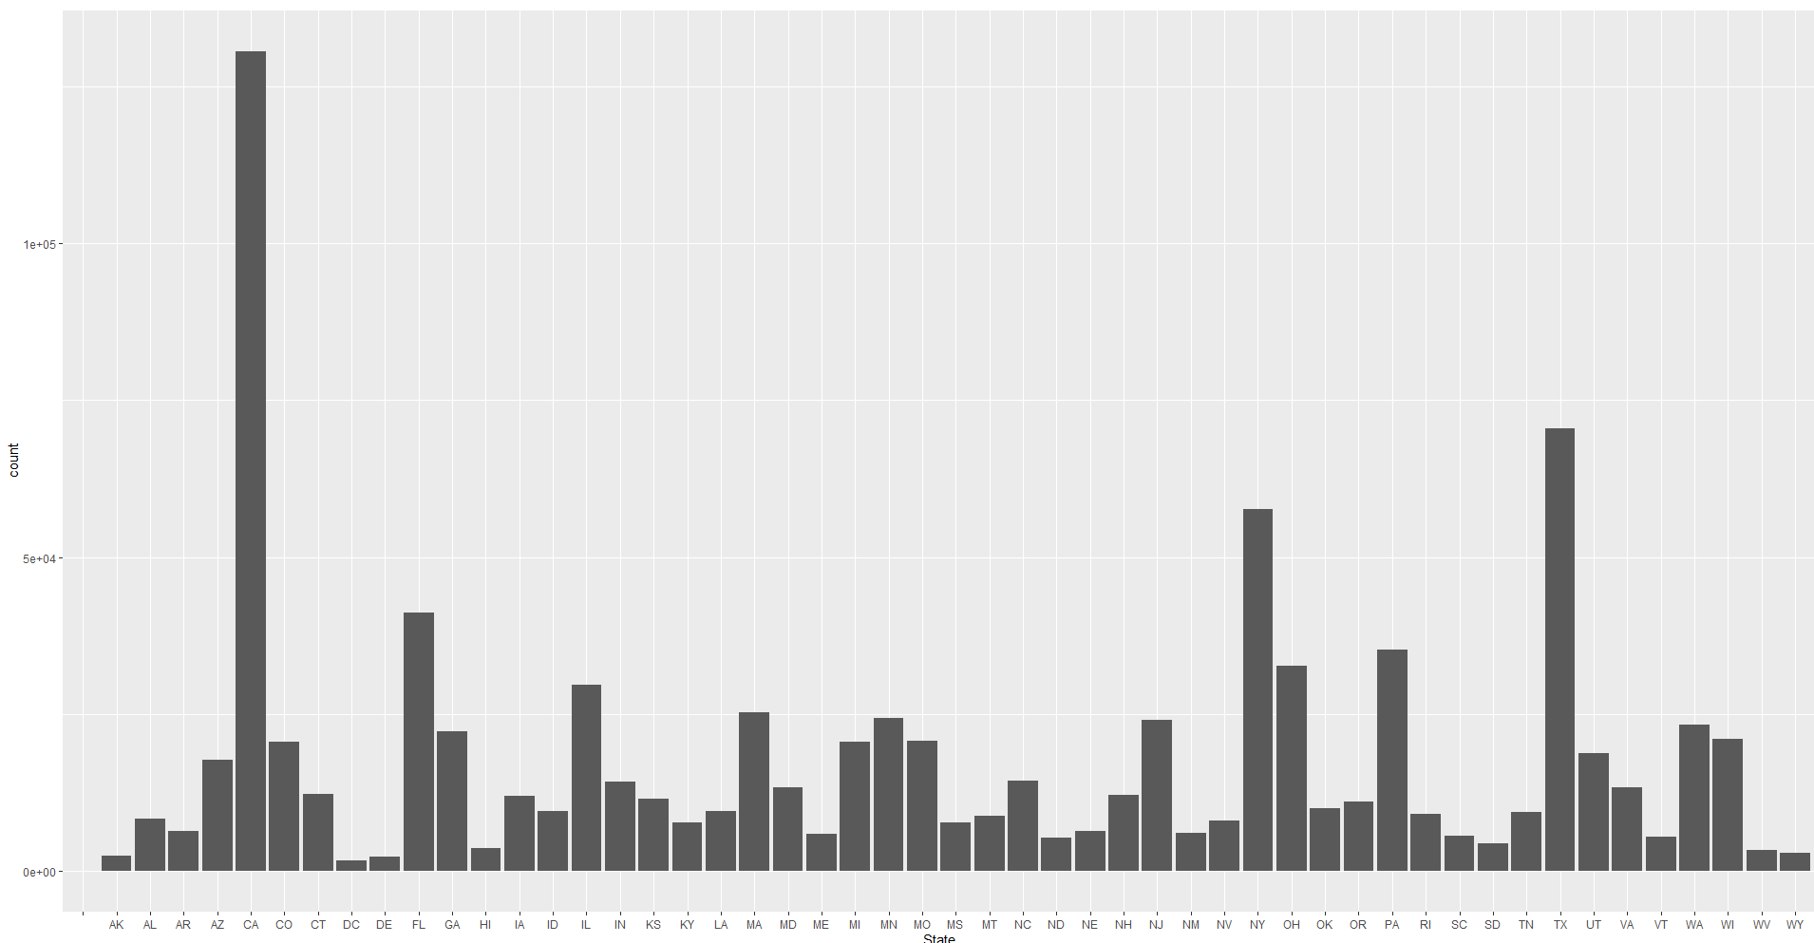
Loans given out to businesses in states

Slide 6
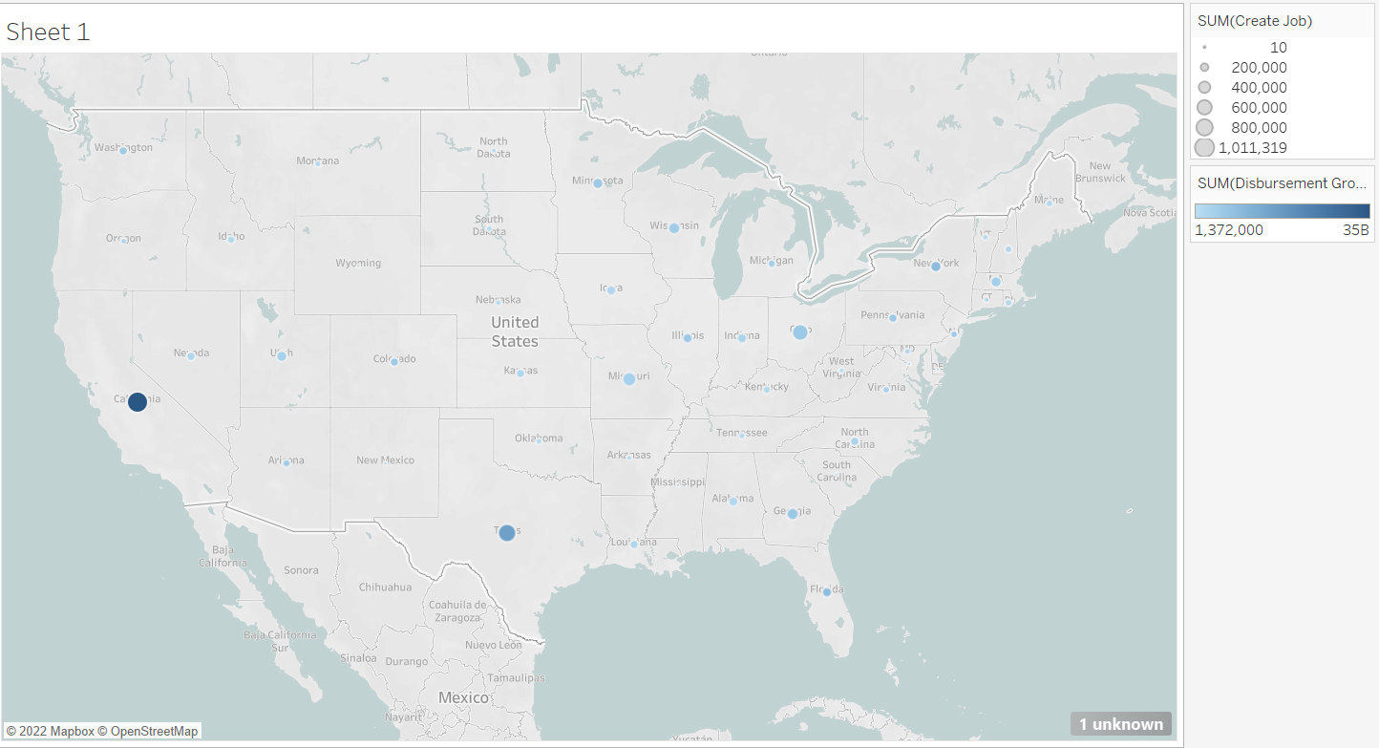

Slide 7
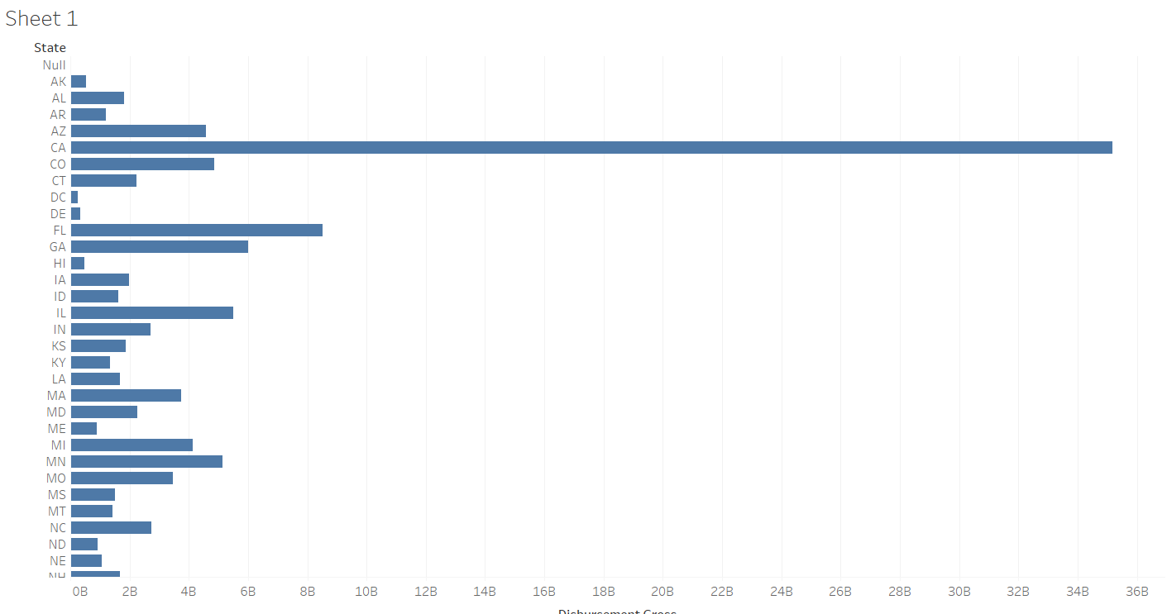

Slide 8
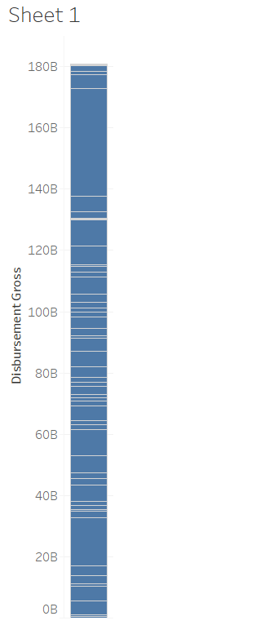

Slide 9
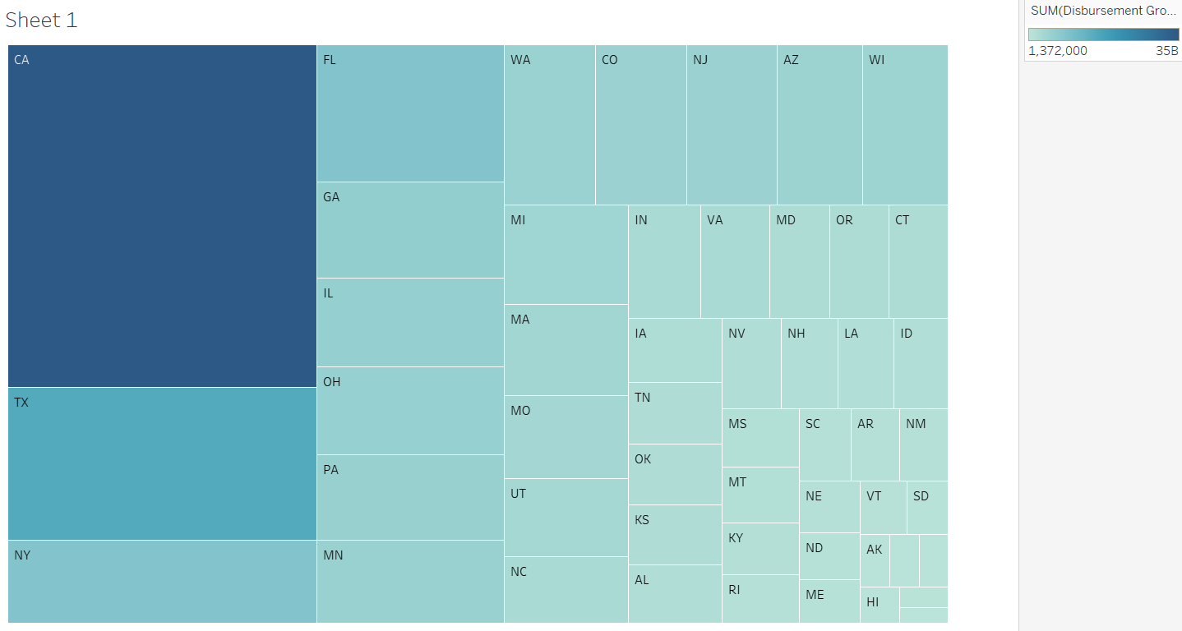

Slide 10
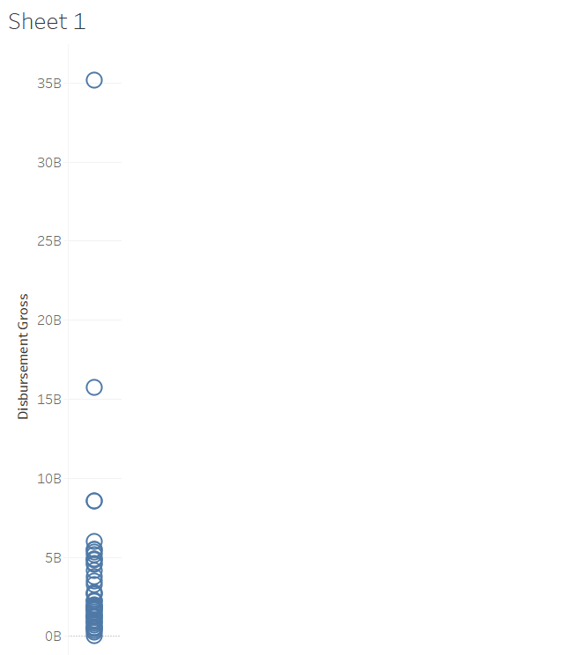

Slide 11
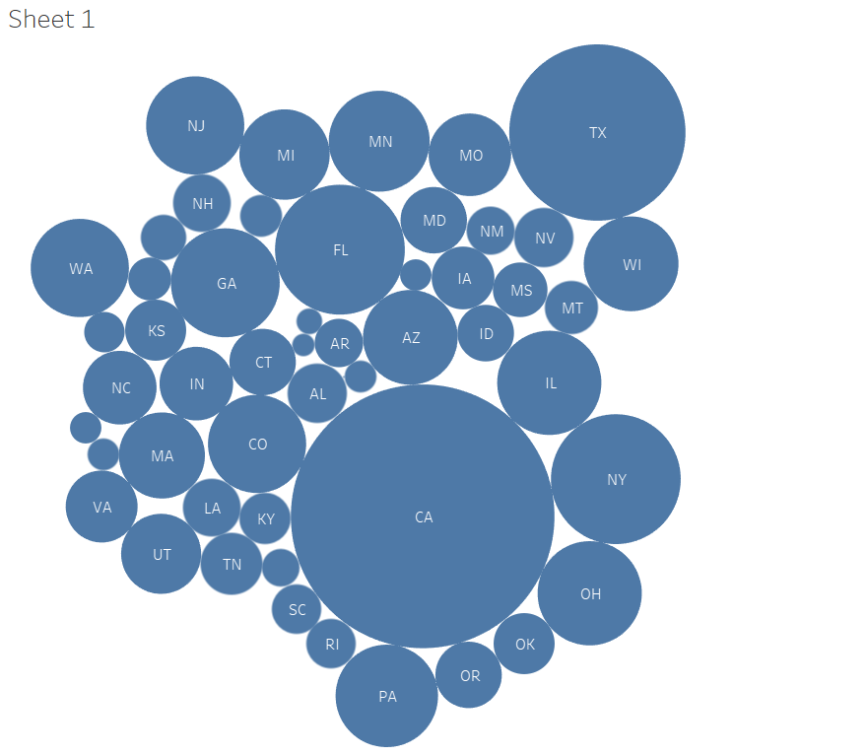

Slide 12
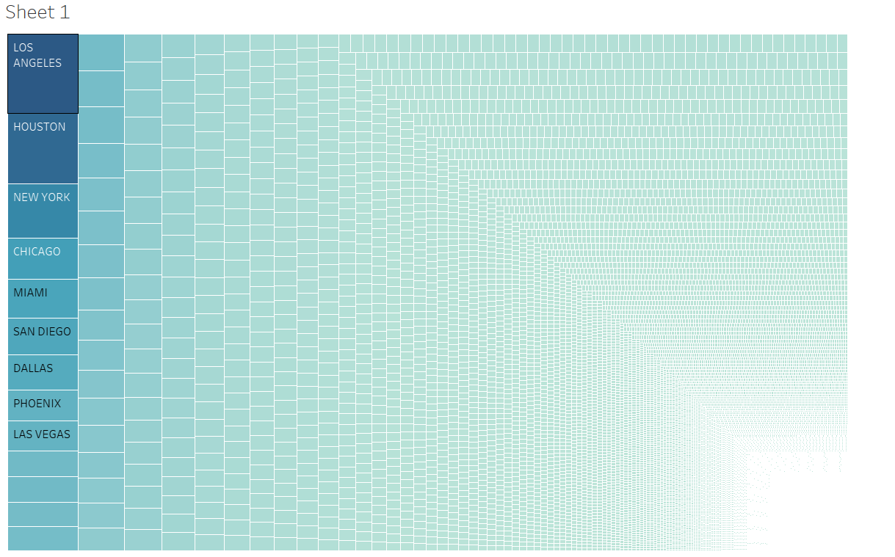

Slide 13
Loans given out to businesses in states
We see a clear trend here where: 1) States with the most populations get the most amount of loans compared to others. 2) States that we consider today to be economic powerhouses or economic hubs were vitalized by the loans. 3) And lastly we see that states with a big workers’ base and technological literate population get the most amount of loans and open businesses

Slide 14
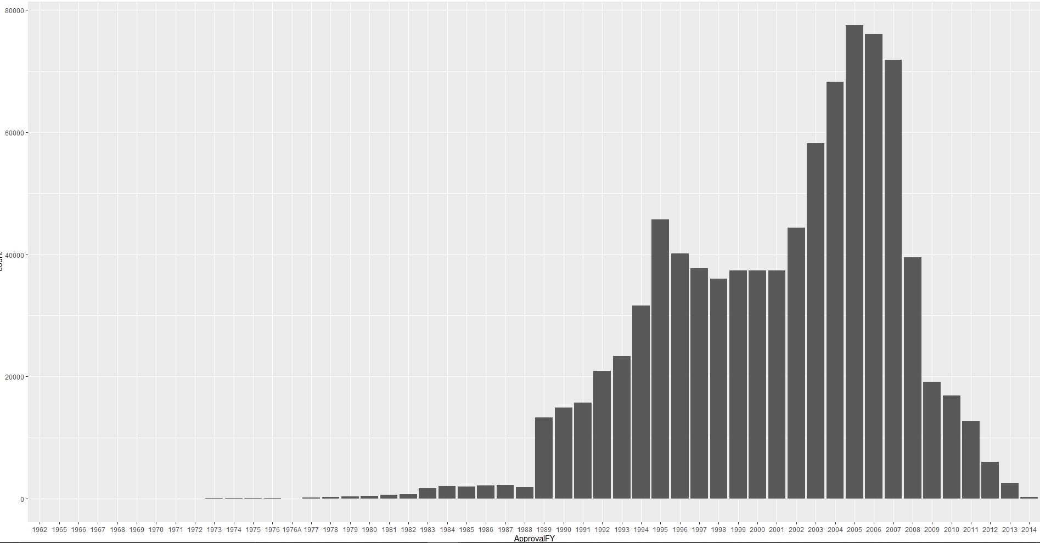
Loans given out by Approval year

Slide 15
Loans given out by Approval year
We see a significant rise first at 1989 when the U.S had a light recession for nearly 5 years. During that time, the Government made helping small businesses go through the recession its priority.
We later see the more significant rise in the years leading to the Financial crisis in 2008 and the years around it.

Slide 16
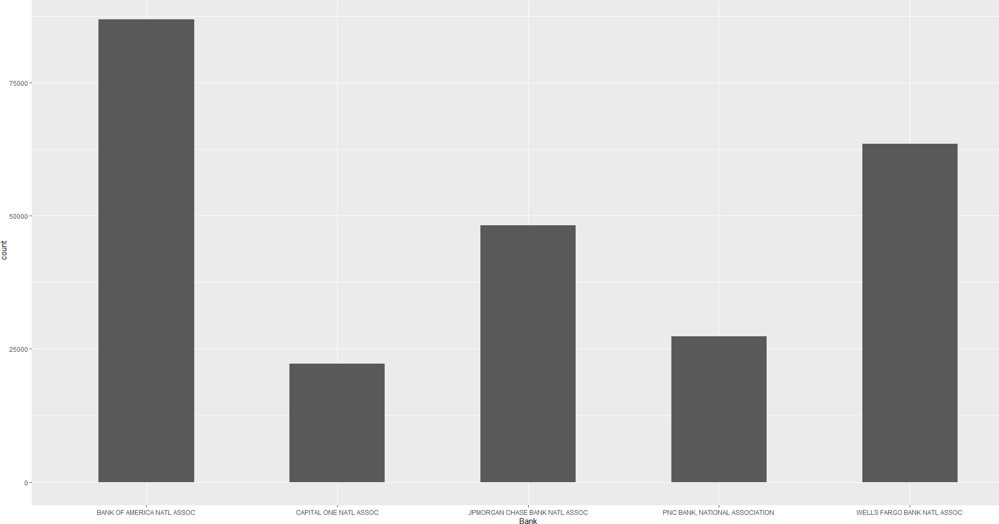
Loans given out by Major banks

Slide 17
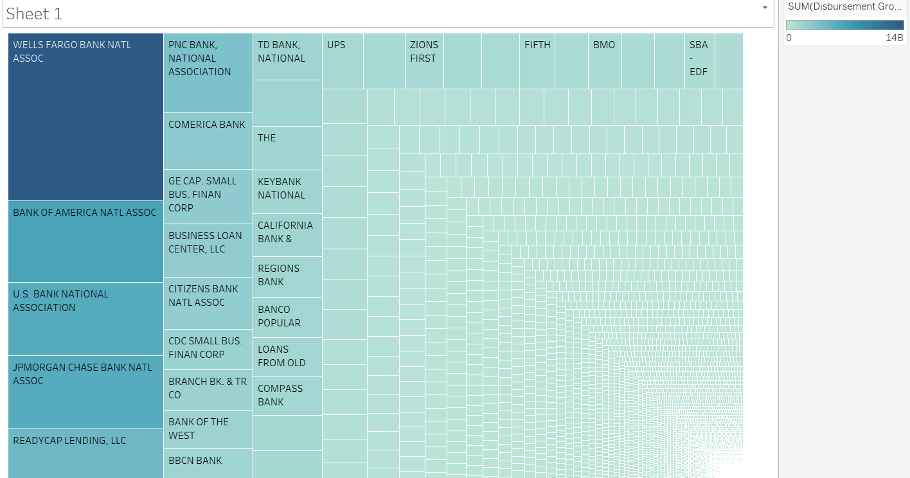

Slide 18
Limitations of Data provided
The most major limitation was that the dataset didn’t provide a column that categorized each business to an industry. I have looked for similar data which specified the industry for each business, but I couldn’t find a dataset as wide and as expansive as the one originally provide by the SBA.

Slide 19
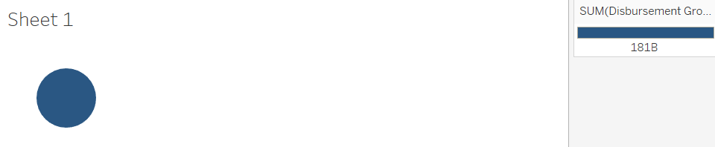
Other Visualizations

Slide 20
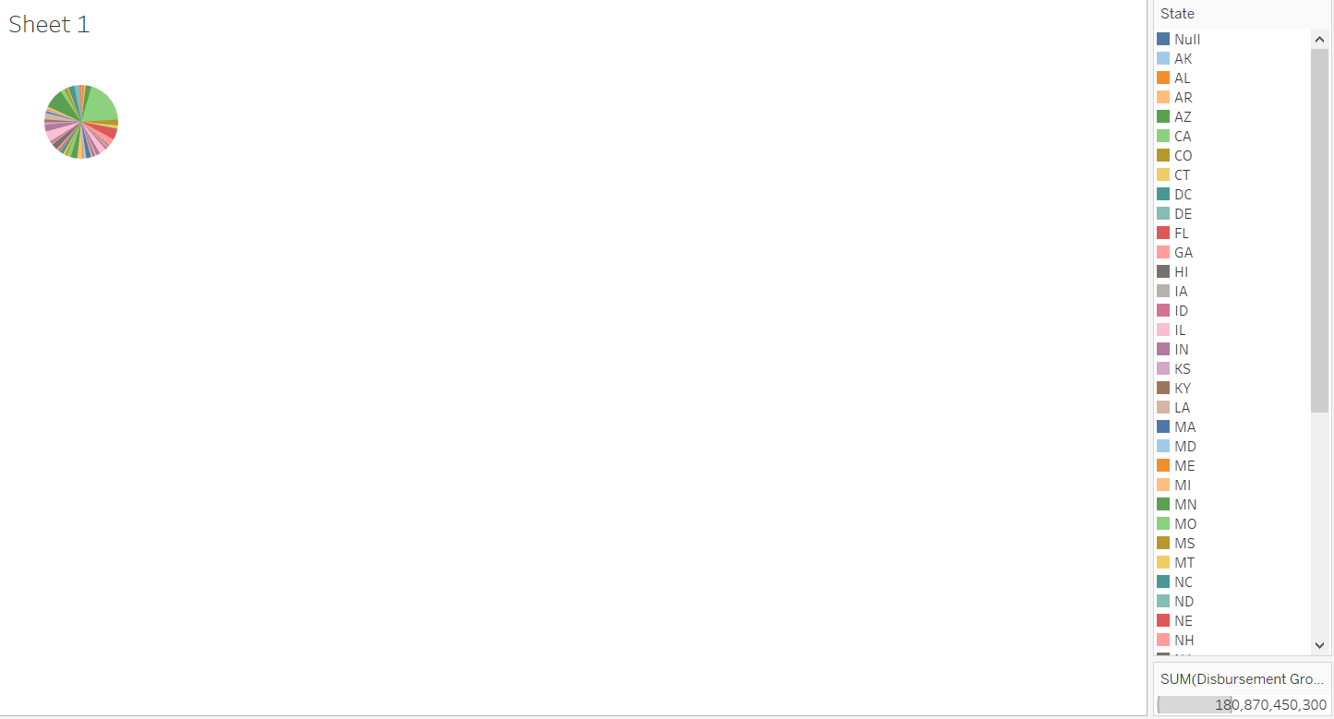

Slide 21
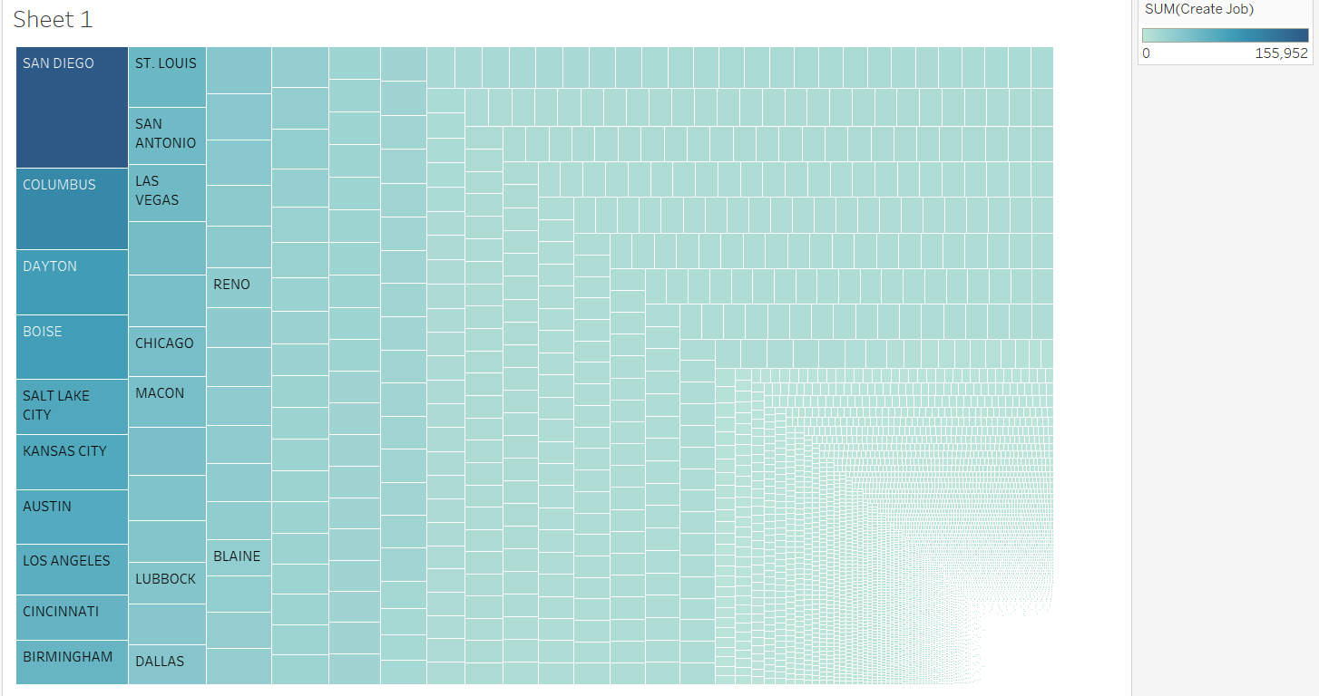

Slide 22
Sources Cited and Used outside the Dataset
https://advocacy.sba.gov/2019/01/30/small-businesses-generate-44-percent-of-u-s-economic-activity/#:~:text=WASHINGTON%2C%20D.C.%20%E2%80%93%20Small%20businesses%20are,percent%20of%20U.S.%20economic%20activity.
https://www.pnas.org/doi/10.1073/pnas.2006991117#:~:text=Across%20the%20sample%2C%2041.3%25%20of,closed%20because%20of%20the%20pandemic.

